Slide 1
Information Retrieval

Slide 2
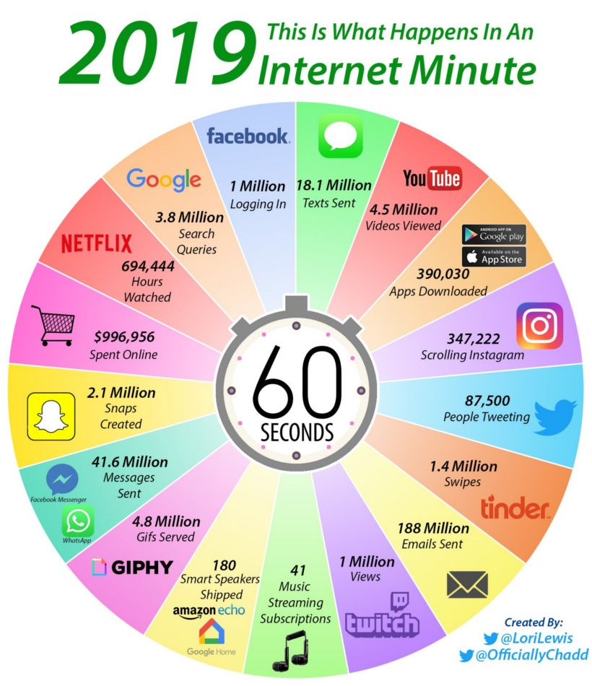
Introduction
2019: What
Happens in An
Internet Minute

Slide 3
Information overload problem
“The greatest problem of today is how to teach people to ignore the irrelevant, how to refuse to know things, before they are suffocated. For too many facts are as bad as none at all.” (W.H. Auden)
Information Retrieval : Solution to combat information overload problem

Slide 4
Definition (IR)
“Information retrieval (IR) deals with the representation, storage, organization of, and access to information items.”
“Modern Information Retrieval”, Baeza Yates and
Berthier Ribeiro Neto,
“Information retrieval (IR) is finding material (usually documents) of an unstructured nature (usually text) that satisfies an information need from within large collections (usually stored on computers”)
“Introduction to Information Retrieval”, Manning and
Prabhakar
Most prominent example: Web Search Engines
E-mail search Searching your laptop
Corporate knowledge bases Legal information retrieval

Slide 5
IR – Example
QUERY: Which plays of Shakespeare contain the words
Brutus AND Caesar but NOT Calpurnia?
Document corpus: Shakespeare’s Collected Works
One could grep all of Shakespeare’s plays for Brutus and Caesar, then strip out lines containing Calpurnia?

Slide 6
Set / Ranked retrieval
In a set retrieval approach, the system partitions the corpus into two subsets of documents: those it considers relevant to the search query, and those it does not.
In a ranked retrieval approach, the system responds to a search query by ranking all documents in the corpus based on its estimate of their relevance to the query.
Non Relevant
Documents
1. doc1
2. doc2
3. doc3
…….
Relevant
Documents

Slide 7
Ranking – Document retrieval
D d j
Ranking
Model
Query

Slide 8
IR - Web Search System
Web
Spider/Crawler
Document
corpus
Query String
IR
System
1. Page1
2. Page2
3. Page3
.
.
Ranked
Documents

Slide 9
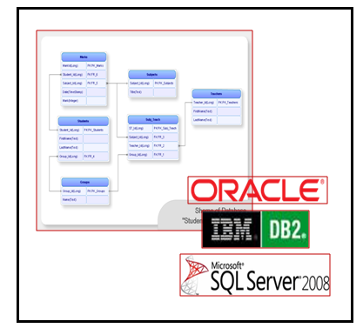
DB Vs IR
DB : Structured Data
Structured, complex data models with rich meta-data
Accessed by query languages
No notion of relevancy
High search quality
Small user population that masters DB
focus on concurrency control and recovery
eno | ename | dept | pay | skill
123 | ram | …. | ….. | …..
124 | asha | …. | …. | ….
126 | raj | …. | …. | ….
127 | sam | ….. | …. | ….
R
Query : Select eno from emptable where ename=‘ram’
NR
NR
NR

Slide 10
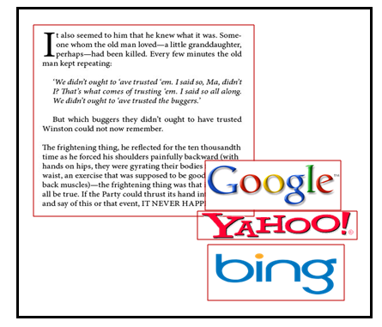
DB Vs IR
IR : Unstructured Data
Minimal/No structure
Accessed by keywords
Limited search quality
Large user population
Query - free text , Boolean combinations of keywords
Ranking of documents on estimated degree of relevance of the documents to the query
Less focus on concurrency control and recovery
Query : algorithm analysis design

Slide 11
Relevance
Relevance is a subjective judgment and may include:
Being on the proper subject.
Being timely (recent information).
Being authoritative (from a trusted source).
Satisfying the goals of the user and his/her intended use of the information (information need).

Slide 12
Information Retrieval as a Process
Information Need
Document Objects
Representation
Representation
Query
Indexed Objects
Comparison
Relevant?
Evaluation/Feedback
Retrieved Objects

Slide 13
IR – Basic Retrieval Process
QUERY: Which plays of Shakespeare contain the words
Brutus AND Caesar but NOT Calpurnia?
Document corpus: Shakespeare’s Collected Works
One could grep all of Shakespeare’s plays for Brutus and Caesar, then strip out lines containing Calpurnia?
Why is that not the answer?
Slow (for large corpora)
Other operations (e.g., find the word Romans near countrymen) not feasible
No Ranked retrieval

Slide 14
Term-document incidence
1 if play contains word, 0 otherwise
Brutus AND Caesar BUT NOT Calpurnia

Slide 15
Incidence vectors
So we have a 0/1 vector for each term.
To answer query: take the vectors for Brutus, Caesar and Calpurnia (complemented) ➔ bitwise AND.
110100 AND
110111 AND
101111 = 100100.
The answers for this query are thus
Antony and Cleopatra and Hamlet

Slide 16
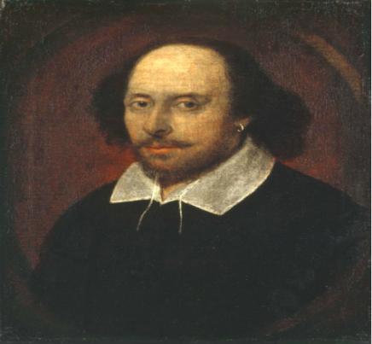
Answers to query
Sec. 1.1
Antony and Cleopatra, Act III, Scene ii
Agrippa [Aside to DOMITIUS ENOBARBUS]: Why, Enobarbus,
When Antony found Julius Caesar dead,
He cried almost to roaring; and he wept
When at Philippi he found Brutus slain.
Hamlet, Act III, Scene ii
Lord Polonius: I did enact Julius Caesar I was killed i’ the
Capitol; Brutus killed me.
Notes:
Wikimedia commons picture of Shake

Slide 17
IR Systems
Online Systems
Dialog, LexisNexis, etc.
Web Systems
Alta Vista, Excite, Google, etc.
Scientific Literature Systems
CiteSeer, PubMed, BioMedNet, etc.

Slide 18
Web search :
Search ground are billions of documents on millions of computers
spidering; efficient indexing and search; malicious manipulation to boost search engine rankings; Link analysis
Enterprise and institutional search:
e .g company’s documentation, patents, research articles
Often domain-specific
Centralised storage; dedicated machines for search.
Most prevalent IR evaluation scenario: US intelligence analyst’s searches
Personal information retrieval (email, pers. documents;)
e.g., Mac OS X Spotlight; Windows’ Instant Search
different file types; maintenance-free, light weight to run in background

Slide 19
Components of IR system
1. collection of documents
– text, image or multimedia documents, or document surrogates (for example bibliographical records)
2. indexing system
– indexing and searching methods and procedures (an indexing system can be human or automated);
3. defined set of queries
– which are input into the system, with or without the involvement of a human searcher; and
4. evaluation criteria
– specified measures by which each system is evaluated, for example ‘precision’ and ‘recall’ as measures of relevance
Precision : Fraction of retrieved docs that are relevant to the user’s information need
Recall : Fraction of relevant docs in collection that are retrieved

Slide 20
What to read?
Web Applications,
Bioinformatics…
Machine Learning
Pattern Recognition
Library & Info
Science
ICML, NIPS, UAI
Information Retrieval
Statistics
Optimization
NLP
SIGIR, WWW, WSDM, CIKM
Databases
ACL, EMNLP, COLING
SIGMOD, VLDB, ICDE
Data Mining
Software engineering
Computer systems
KDD, ICDM, SDM

